Slide 1
The employment problem
Neeraj kumar sharma
Lecturer in Economics
GBSSS ROHRU

Slide 2
Who is unemployed
Person willing and ready to work at prevailing rate of wages but does not get work.
Voluntarily unemployed is not counted
Person willing but not able to work is also not counted
Person in age group 15 to 60 is only counted.

Slide 3
Labour supply
Supply of labour corresponding to different wage rate.
Supply of labour can increase or decrease even when number of workers are constant
It is measured in term of man days
One man day referring to eight hours of work.

Slide 4
Labour force
Number of persons actually working or willing to work.
Not related to wage rate
Labour force increases or decreases only when actual working or willing to work person increases or decreases.
It is measurement of potential labour force

Slide 5
Workforce
Number of person actual working
Does not account for those who are willing to work
It is measurement of actual labour force

Slide 6
Labour force - workforce =number of person unemployed

Slide 7
Participation rate
Percentage of population actually participating in production activity.
Workforce/total population*100

Slide 8
Usual status of employment unemployment
Person usually spends majority of his time in work
In India 183 days of work is standard cut off for usual status.
Rate of unemployment by usual status= number of person unemployed by usual status/size of labour force

Slide 9
Weekly status
If a person is part of workforce 7 days prior to the day interviewed. Person is considered employed

Slide 10
Daily status
Estimated in term of person days
No of man days willing to work – no. Of man day actually work= unemployment by daily status
Rate of unemployment by daily status= No of mandays wasted/No of mandays actually available

Slide 11
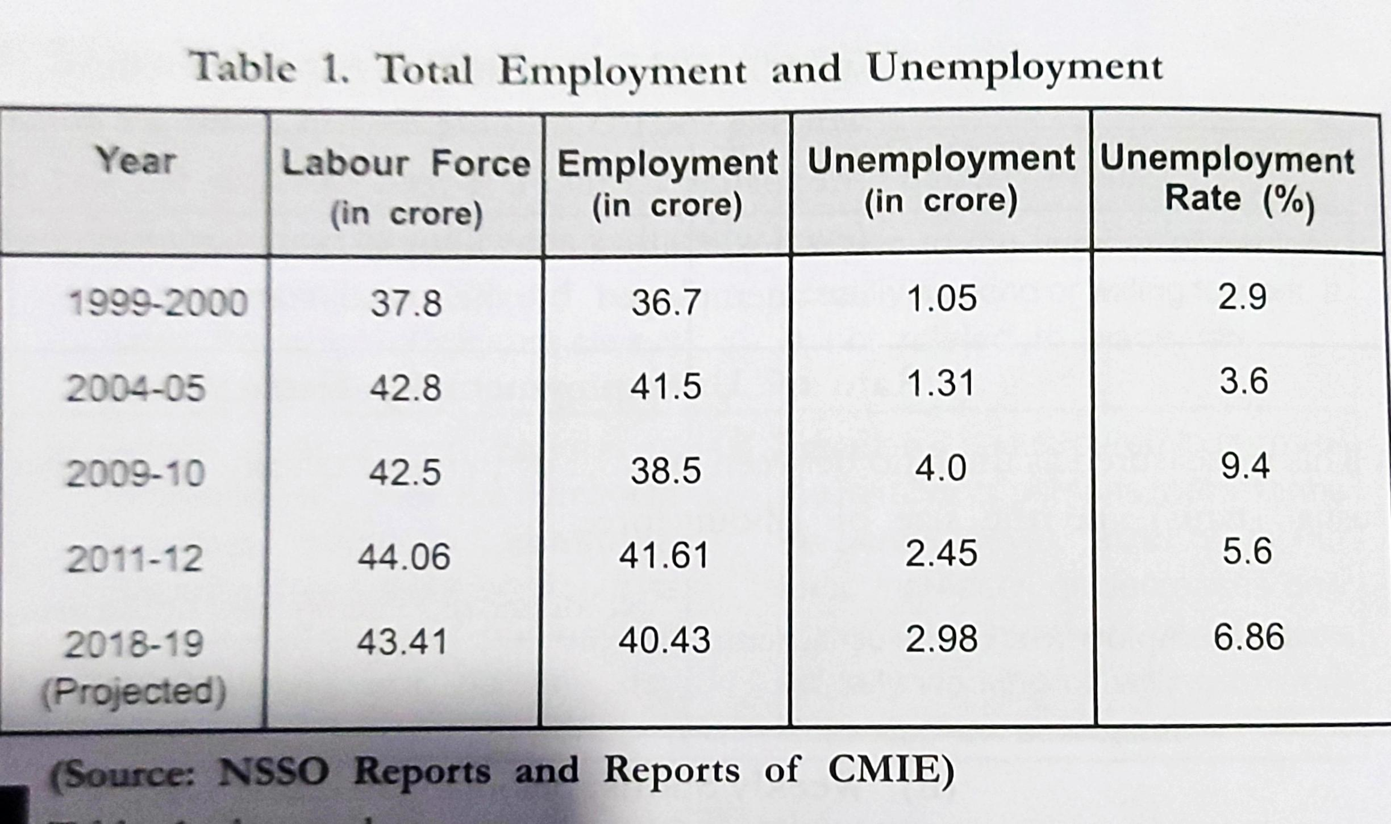
Extent of unemployment in India

Slide 12
Unemployment in India
In minimum in Meghalaya 0.41%
Maximum in Tripura 19.7%
Kerala Karnataka Andhra Pradesh Tamil Nadu Odisha West Bengal and Bihar unemployment is highest
Meghalaya Nagaland Himachal Pradesh Manipur it is lowest

Slide 13
Unemployment higher in area having characteristics
Large proportion of agricultural labour then cultivator
Greater urbanisation but less development of industries
More pressure of population on agriculture
High rate of literacy.

Slide 14
Economic and social consequences of unemployment
Economic consequences
Non utilisation of manpower
Loss of output
Decline in capital formation
Low productivity.

Slide 15
Social consequences
Low quality of life
Greater inequality
Social unrest
Class struggle

